Slide 1
Mouse Training
1.3 Mouse Training

Slide 2
We are going to learn
We are going to learn:
What a mouse is.
How to hold a mouse.
How to use a mouse.

Slide 3
What is the mouse
What is the Mouse?
The mouse is an input device designed to manipulate objects on the
computer screen and assist
you, the user, in interacting
with the computer.

Slide 4
How to hold the mouse
How to Hold the Mouse
Holding the mouse correctly will:
Make using it easier and,
more importantly,
2) Prevent stress and strain
on your body!

Slide 5
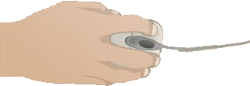
How to hold the mouse
How to Hold the Mouse
Place the mouse close to the keyboard or laptop.
Center the base of the mouse in your palm.

Slide 6
How to hold the mouse
How to Hold the Mouse
Rest your wrist on the mouse pad or desk, with the palm of your hand resting on the back portion of the mouse.

Slide 7
How to hold the mouse
How to Hold the Mouse
Your thumb should rest on the table on one side of the mouse and your pinky finger should rest on the table on the other side.

Slide 8
How to hold the mouse
How to Hold the Mouse
If you are right handed, your index finger should be on the left “button” and your middle finger should be on the right button.

Slide 9
How to hold the mouse
How to Hold the Mouse
If you are left handed, your index finger should be on the right button and your middle finger should be on the left button.

Slide 10
How to hold the mouse
How to Use the Mouse
The mouse controls where the cursor on the screen goes.

Slide 11
The Cursor
The Cursor
The cursor changes shape depending on its location and what it is told to do.

Slide 12
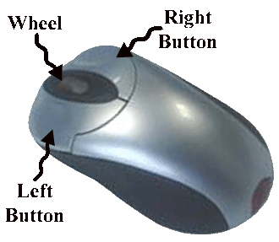
How to use the mouse
How to Use the Mouse
To interact with objects on the screen, the cursor is moved over the object by moving the mouse and a button
on the mouse is
depressed or "clicked."

Slide 13
Time to practice
Time To Practice!

